Slide 1
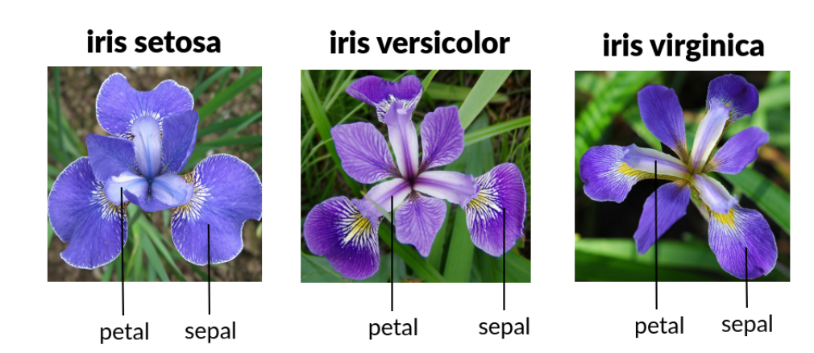
PDAN8411
Chapter 2 : Supervised learning.
Bias and Variance
Over and Under Fitting
KNN

Slide 2
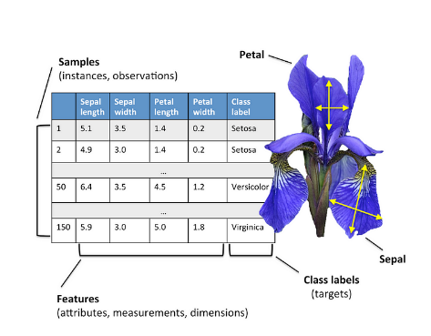
Supervised machine learning
Supervised Machine Learning is a type of machine learning where a model is trained using labeled data—meaning the input data (features) comes with corresponding correct outputs (labels). The goal is for the model to learn patterns from the training data so it can make accurate predictions on new, unseen data.

Slide 3
Classification vs Regression
Feature | Classification | Regression
Definition | Predicts categorical labels (e.g., Yes/No, Spam/Not Spam) | Predicts continuous values (e.g., Price, Temperature)
Output Type | Discrete (classes or categories) | Continuous (numerical values)
Algorithms Used | Logistic Regression, Decision Trees, Random Forest, SVM, Neural Networks | Linear Regression, Polynomial Regression, Decision Trees, Neural Networks
Evaluation Metrics | Accuracy, Precision, Recall, F1-score, AUC-ROC | Mean Squared Error (MSE), R-Squared, Mean Absolute Error (MAE)

Slide 4
Examples?
Classification | Regression

Slide 5
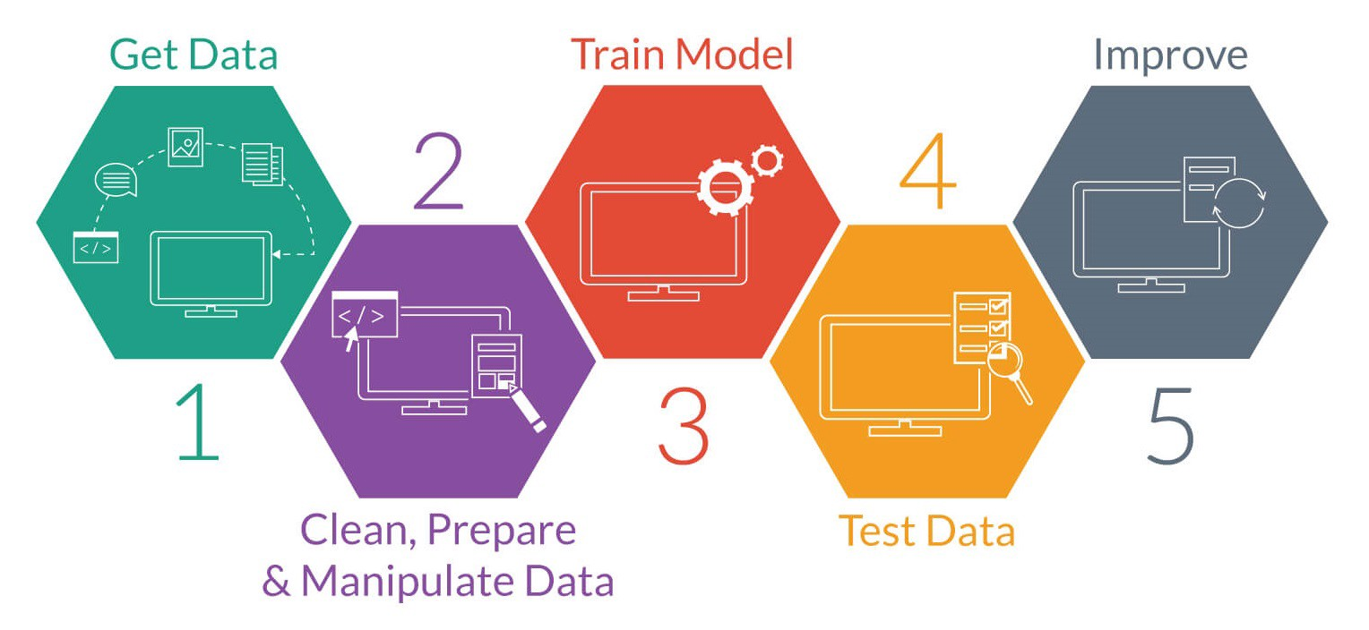
Learning unit Outcomes
Classify machine learning problems as classification or regression problems
1
Distinguish between underfitting and overfitting..
2
Compare different supervised learning algorithms.
3
Apply supervised learning algorithms to solve problems.
4
Calculate uncertainty estimates from classifiers.
5

Slide 6
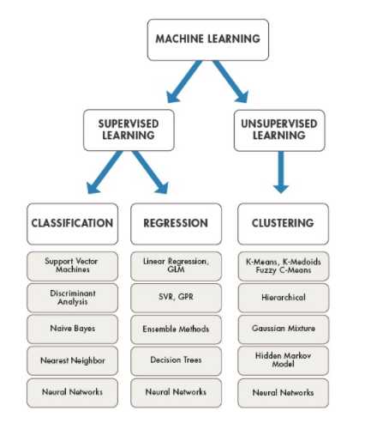

Slide 7
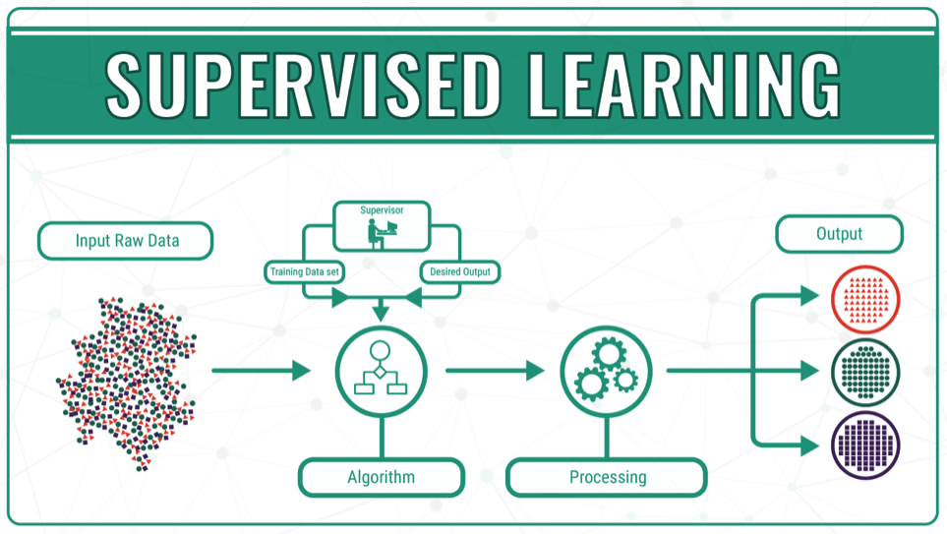

Slide 8
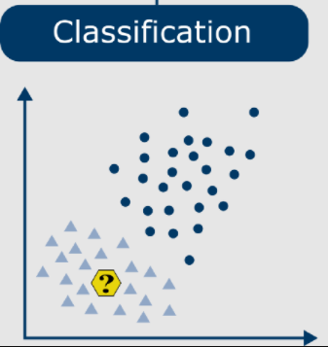
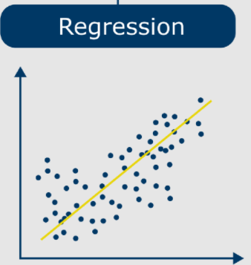
Continuity ?
Predict the class label from a pre-defined list of possibilities
Predict a continuous number or floating point :
-income
-age
-yield of corn production
Can be binary or multiclass

Slide 9
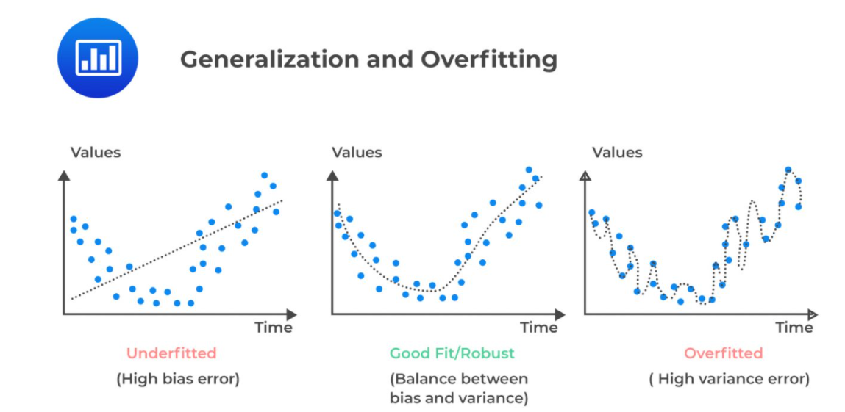
Accurate predictions = generalizable
No variability
Fit model too closely to particulars of training set
Sweetspot
https://analystprep.com/study-notes/cfa-level-2/quantitative-method/overfitting-methods-addressing/

Slide 10
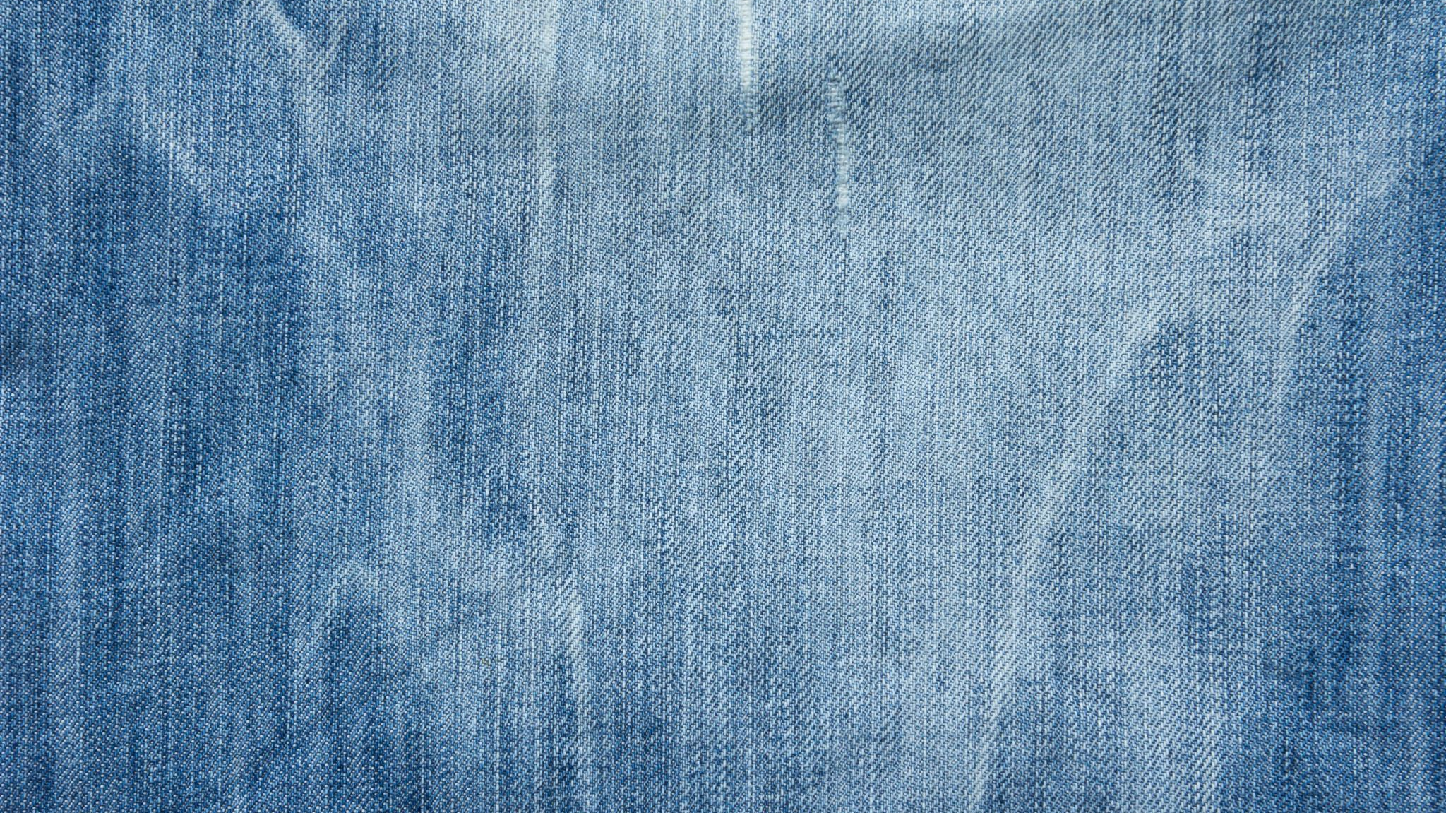
We want to make and sell jeans

Slide 11
Under fitting

Slide 12
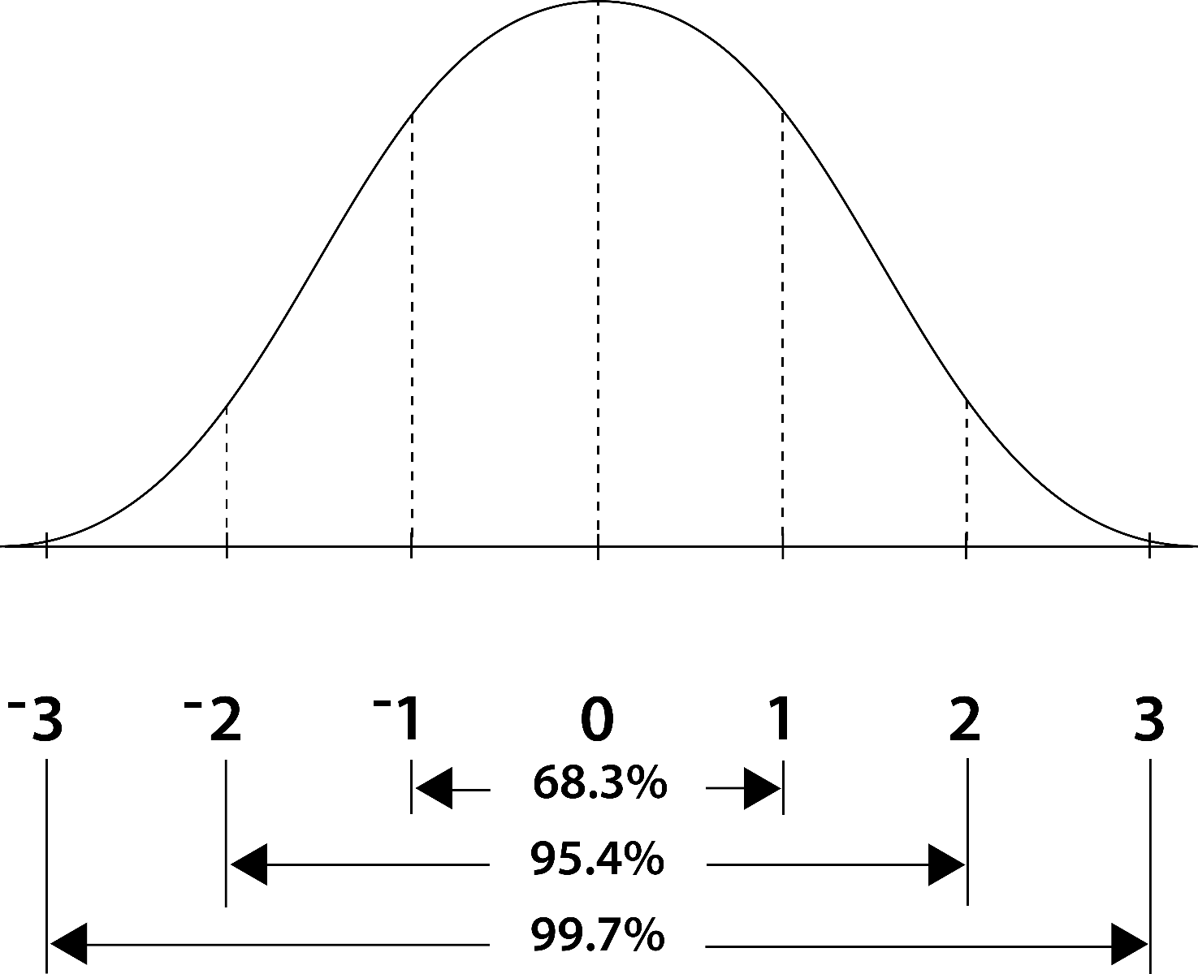
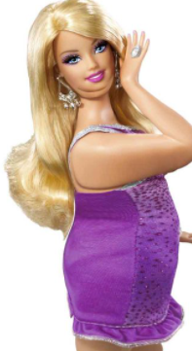
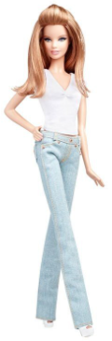
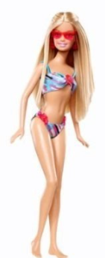
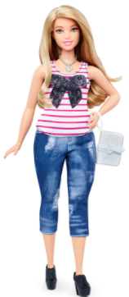
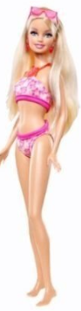
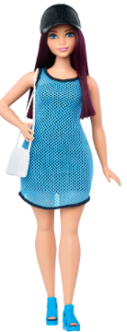
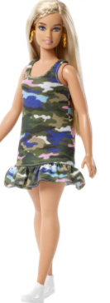

Slide 13
We use only one neighbor to train our model
It builds this model
We make these pants
High bias and low variance are good indicators of underfitting
when a model is too simple, which can be a result of a model needing more training time, more input features, or less regularization. Like overfitting, when a model is underfitted, it cannot establish the dominant trend within the data, resulting in training errors and poor performance of the model

Slide 14
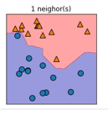
These pants really really don’t match the data , it is vanilla pants…
And they will only ever fit this exact woman……. Or model…..
Our jeans fits our model well… it follows all her curves
54cm
168cm

Slide 15
We make pants for 32% of the population……

Slide 16
Over fitting

Slide 17
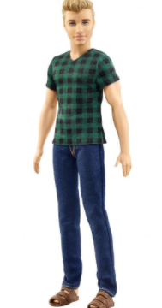
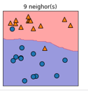
We add too many neighbors
Our model becomes very complex

Slide 18

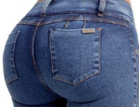
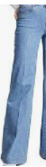
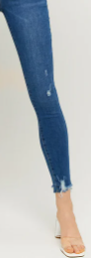

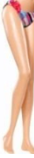
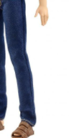
It looks like this
We can make these jeans

Slide 19
Put simply, overfitting is the opposite of underfitting, occurring when the model has been overtrained or when it contains too much complexity,
resulting in low bias but high variance (i.e. the bias-variance tradeoff). In this scenario, the statistical model fits too closely against its training data, rendering it unable to generalize well to new data points

Slide 20
We are looking for a new job, our jeans only fits the freak we created

Slide 21

Bias Variability Trade off

Slide 22
Bias = inability to match the true relationships if the data
Variability = distance between training and test data (line and data)
Hot
Crazy

Slide 23
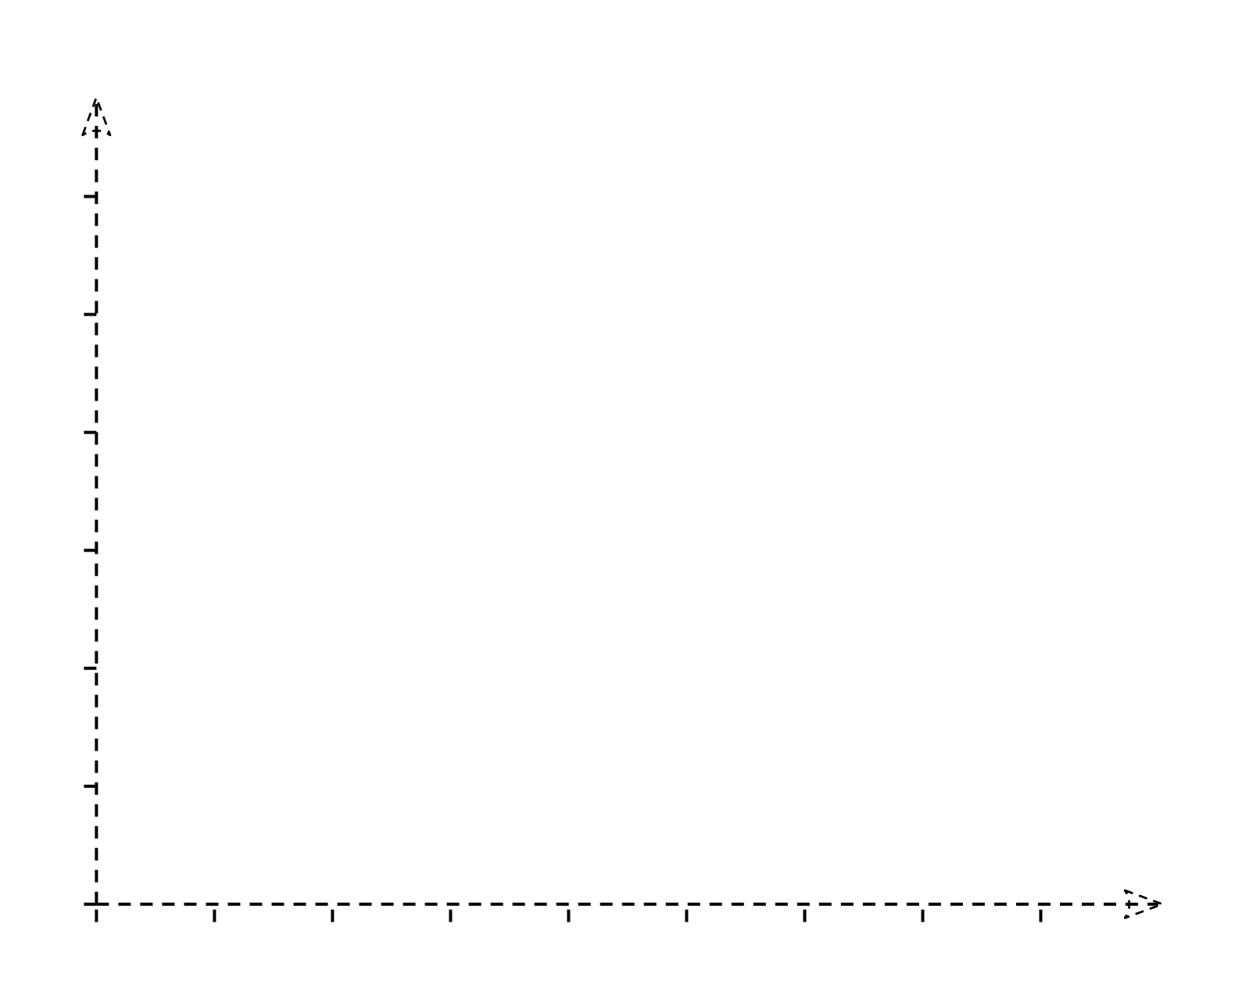
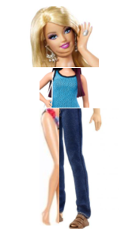
We can draw a flexible line that matches data exactly = low bias
Hot
Crazy

Slide 24
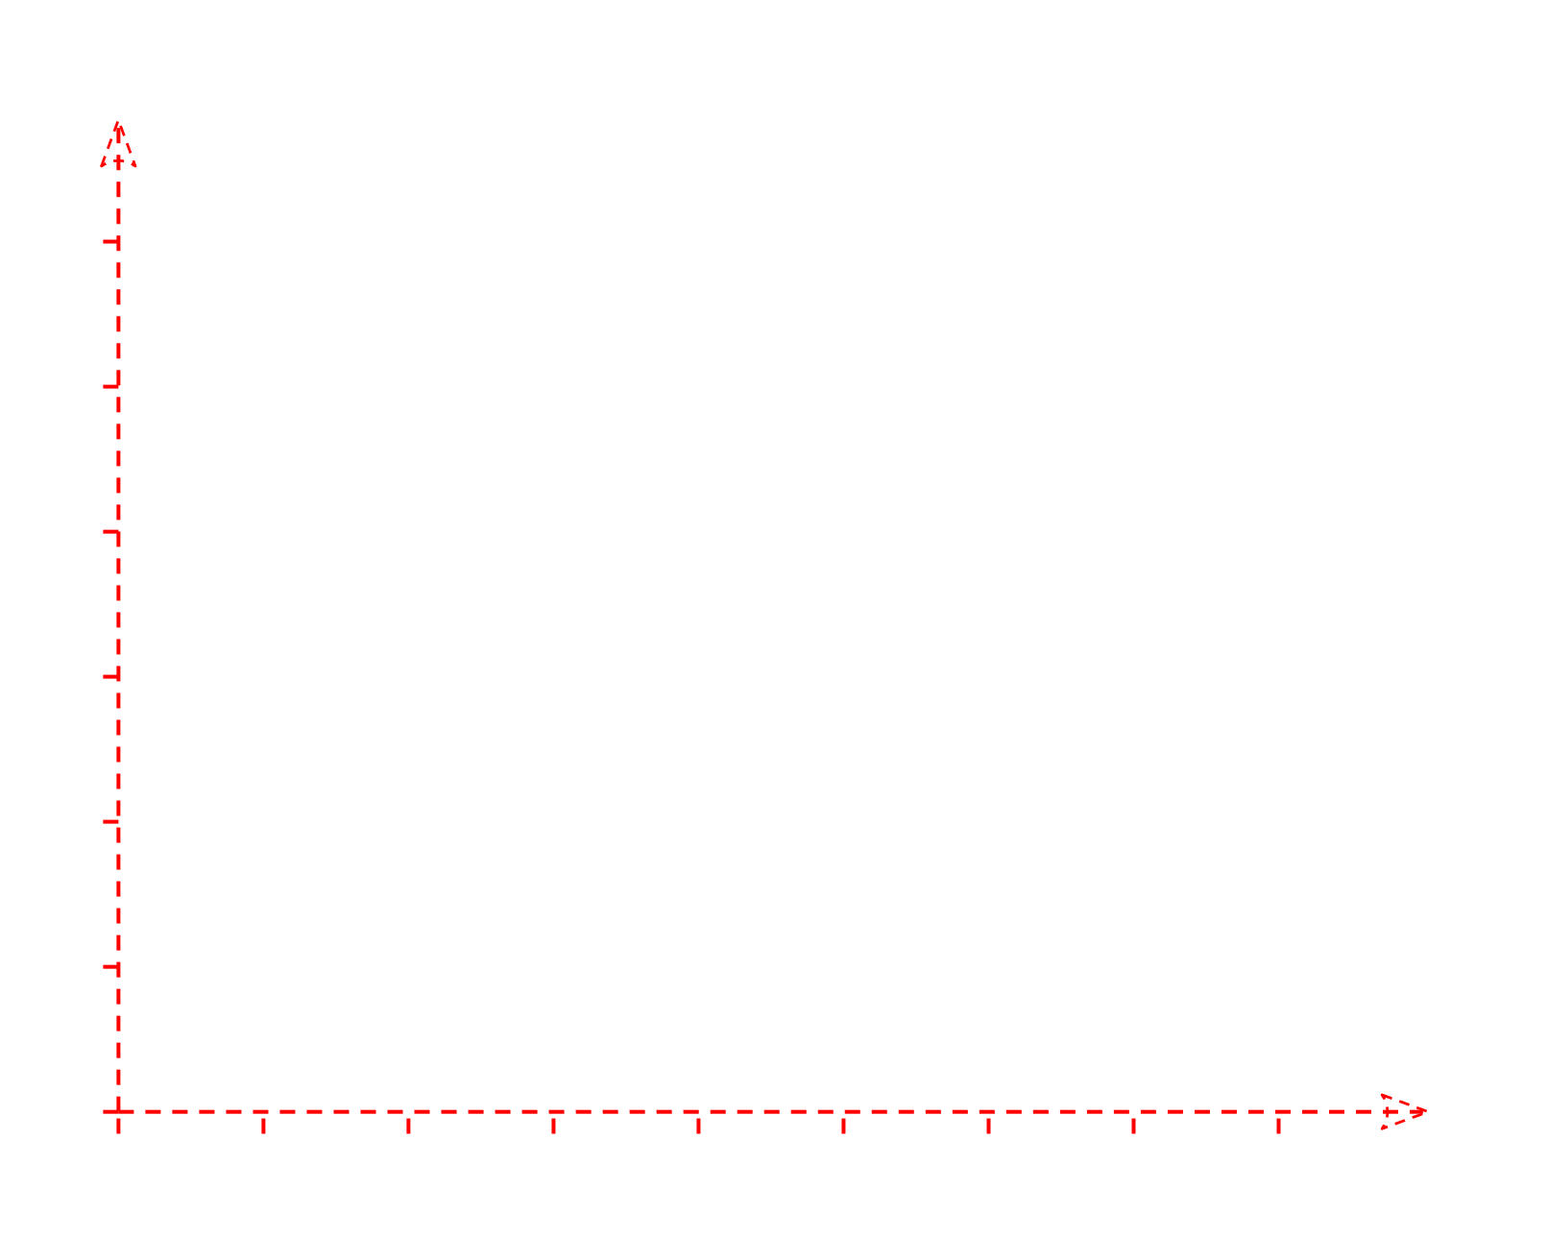
Distance between training and test data is big = variability
Low bias , High variance
Hot
BUT this gives High variability
Crazy

Slide 25
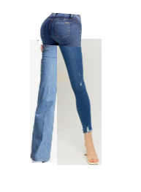
These pants do not fit any member of our population – we have over fitted

Slide 26
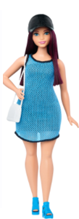
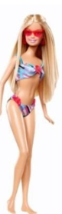
Distance between training and test data is big = variability
Low bias , High variance
BUT this gives High variability = different sums of squares
IE the pants are FAR different from what would the other barbies
The distance (difference ) from what would fit a test a barbie and the pants we made for our freak barbie is big !!!!!!
Hot
Crazy

Slide 27
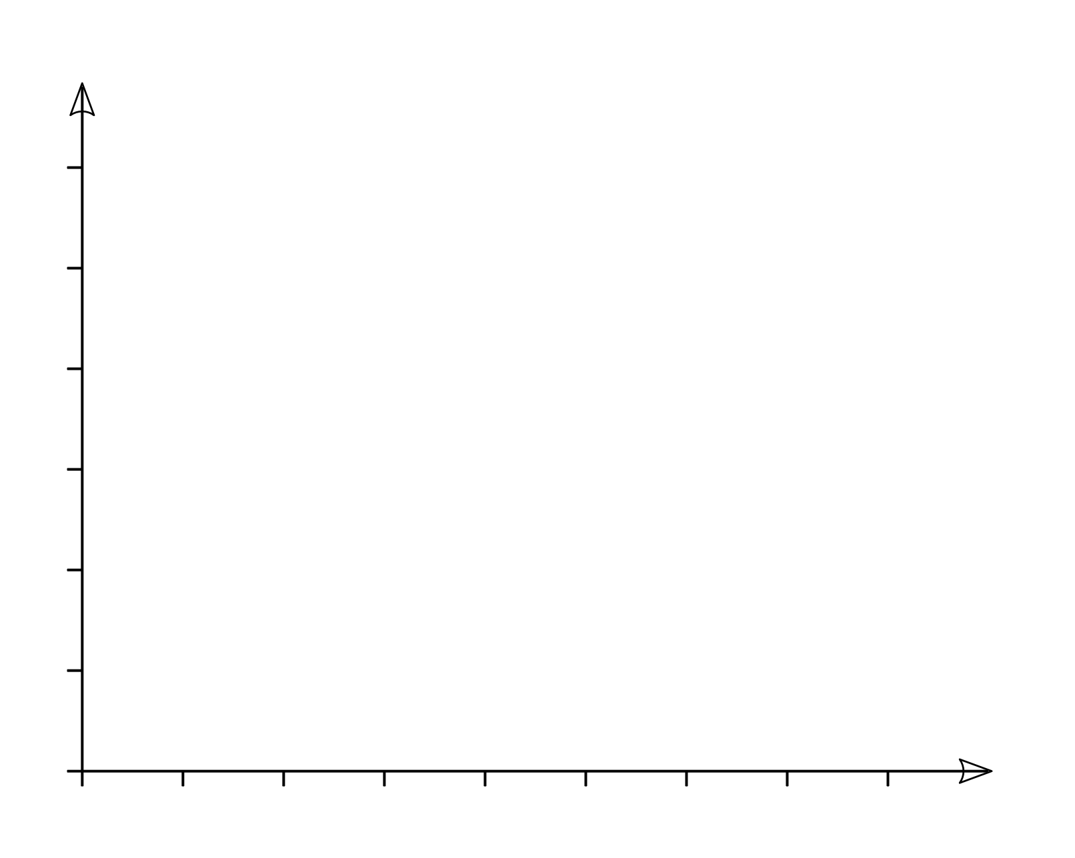
We need to build a model that looks like this barbie
Hot
Lowest possible bias and lowest possible variance – it turns out we have a better change of doing that with a straight line
Crazy

Slide 28
Sweet spot

Slide 29
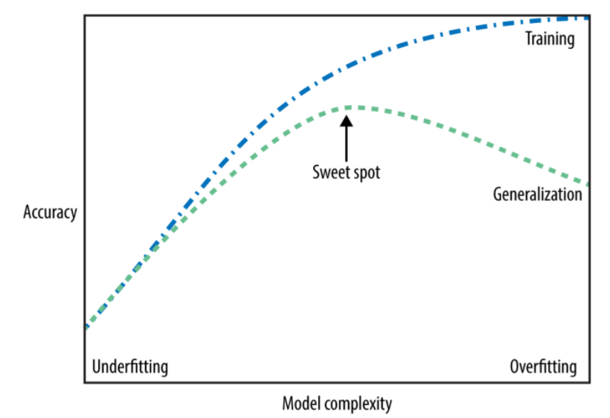

Slide 30
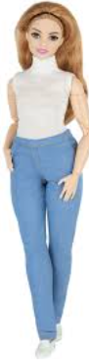
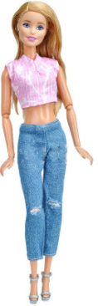
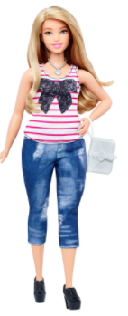
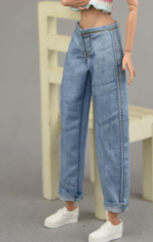
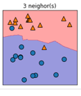
We lose some accuracy, but we can be more general
Our jeans still fit – but they do not follow every curve

Slide 31
We use 3 neighbors
We build this model
We make these jeans

Slide 32
We make pants for 95% of the population……

Slide 33
KNN: K (num) nearest neighbors

Slide 34
Load the data
Initialize K to your chosen number of neighbors
3. For each example in the data
3.1 Calculate the distance between the query example and the current example from the data.
3.2 Add the distance and the index of the example to an ordered collection
4. Sort the ordered collection of distances and indices from smallest to largest (in ascending order) by the distances
5. Pick the first K entries from the sorted collection
6. Get the labels of the selected K entries
7. If regression, return the mean of the K labels
8. If classification, return the mode of the K labels
* Assumes similar things exist in proximity
* Works on proximity principle

Slide 35
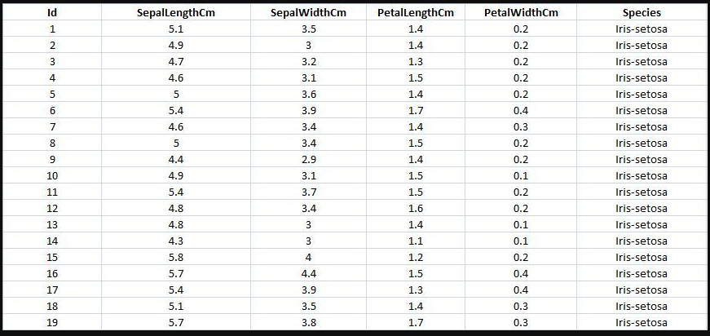
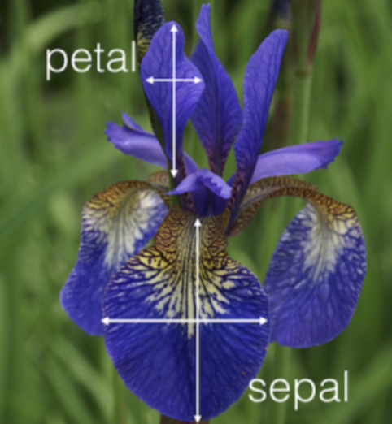
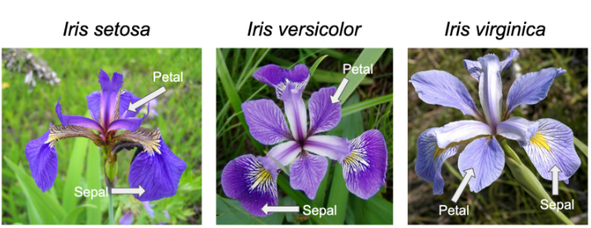

Slide 36
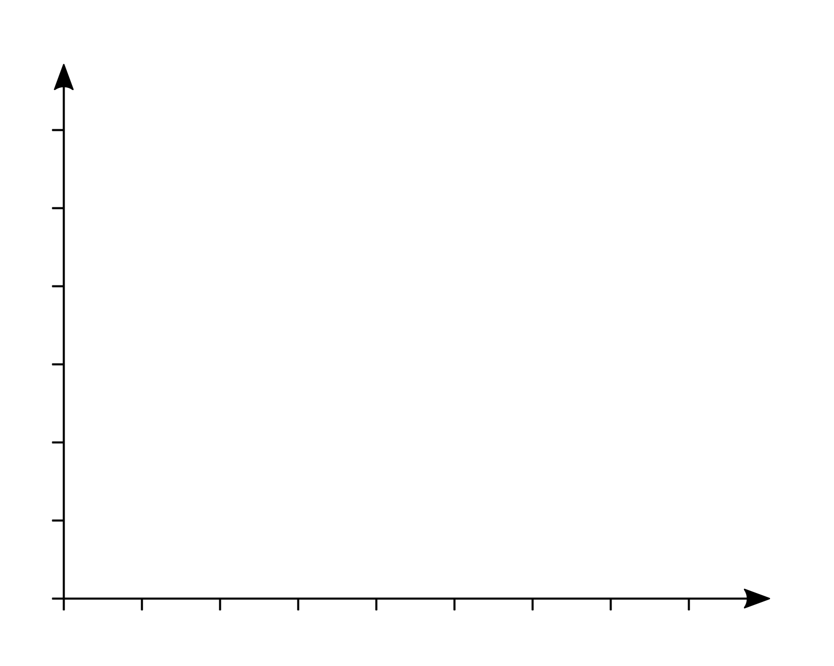





Calculating the Euclidian distance
[1]https://www.youtube.com/watch?v=wTF6vzS9fy4
y
Pythagoras :
$$a^{2}+b^{2}=c^{2}$$
$$m=\frac{yA−yB}{xA−xB}$$
Borrow from slope :
A
x, y
6,4
Flip it :
$$c^{2}=a^{2}+b^{2}$$
C
yA - yB
x, y
$$C^{2}={\left(X_{A}−X_{B}\right)}^{2}−{\left(Y_{A}−y_{B}\right)}^{2}$$
B
2,3
$$C=\sqrt{{\left(x_{A}−x_{B}\right)}^{2}−}{\left(y_{A}−y_{B}\right)}^{2}$$
xA - xB
x
*Slope = change in height / change in horizontal difference
[2]https://www.mathsisfun.com/algebra/distance-2-points.html
[3] https://towardsdatascience.com/machine-learning-basics-with-the-k-nearest-neighbors-algorithm 6a6e71d01761#:~:text=KNN%20works%20by%20finding%20the,in%20the%20case%20of%20regression

Slide 37








Calculating the Euclidian distance
[1]https://www.youtube.com/watch?v=wTF6vzS9fy4
Pythagoras :
$$a^{2}+b^{2}=c^{2}$$
y
$$m=\frac{yA−yB}{xA−xB}$$
Borrow from slope :
A
x, y
Flip it :
6,4
$$c^{2}=a^{2}+b^{2}$$
C
$$C^{2}={\left(6−2\right)}^{2}−{\left(4−3\right)}^{2}$$
yA - yB
x, y
$$C=\sqrt{{\left(6−2\right)}^{2}−}{\left(4−3\right)}^{2}$$
B
2,3
$$C=\sqrt{9−1}$$
xA - xB
$$C=\sqrt{8}$$
$$\text{= }\text{2.82842712475}$$
x
*Slope = change in height / change in horizontal difference
[2] https://towardsdatascience.com/machine-learning-basics-with-the-k-nearest-neighbors-algorithm 6a6e71d01761#:~:text=KNN%20works%20by%20finding%20the,in%20the%20case%20of%20regression

Slide 38

Python implementation of KNN from scratch

Slide 39


Slide 40


Slide 41
KNN: Implementation Google Colab

Slide 42

Number of dimensions
Minkowski parameter that decides if we are using Euclidian or Manhattan distance
The distance between X, and Y
Subtracting values from the two data points
https://www.youtube.com/watch?v=CURkpMxK6hE

Slide 43

Euclidean = in lower dimensions
Manhattan is better for higher dimensions
Euclidean = distance between two points in a straight line
Manhattan = total of all distances between points

